Slide 1



Do Custom LinkedIn Connection Invitations Help Increase the Acceptance Rate?
Group 6
Tien Her, Ivy Zhang, Aditya Satpute, Qinyi Qiu
Notes:
Icon:<a href="https://www.flaticon.com/free-icons/linkedin" title="linkedin icons">Linkedin icons created by Freepik - Flaticon</a>

Slide 2

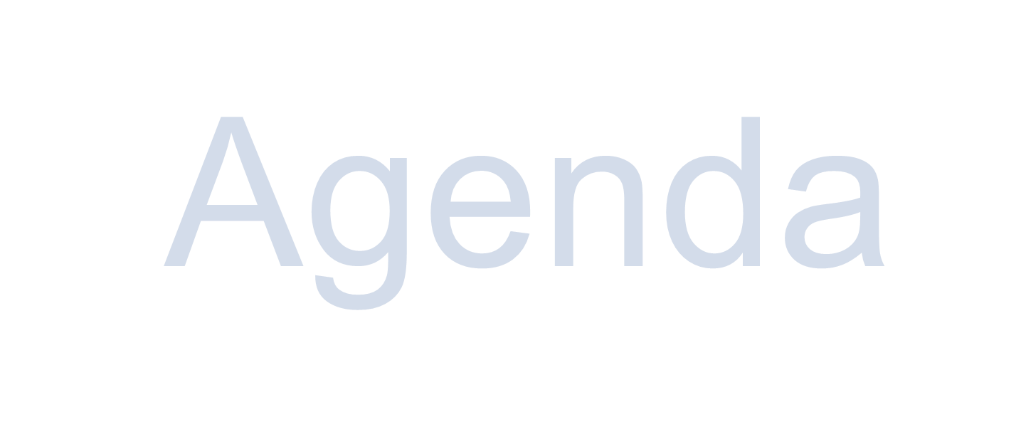


LinkedIn Experiments
Introduction
Experimental Design
Challenges
Execution
Data Analysis
Conclusion
P02 | Agenda

Slide 3
LinkedIn Experiments
We want to investigate the impact of custom messages on response rates when connecting with individuals on LinkedIn:
Does the inclusion of a custom message with your connection requests lead to a higher acceptance rate?
Should you keep it short and sweet, or cram as much information as possible within the 300-character limit?
Can ChatGPT make your life easier?
P03 | Introduction

Slide 4





Design Overview
Create hypothesis
Experimental Design
Pilot & Decide sample size
Roll out experiment
Analyze result
P04 | Design

Slide 5


Experimental Design
Target Population & Recruitment Strategy:
50%
Balanced Approach
Recruitment Strategy
Data Scientist
P05 | Design
Notes:
https://www.flaticon.com/free-icon/woman_6997662?term=profile&page=1&position=21&origin=search&related_id=6997662
https://www.flaticon.com/free-icons/human-resources

Slide 6
Treatments
Control group: Connection requests without custom messages.
Treatment group: Connection requests with custom messages.
Variables:
50 characters invitation note generated by Chat GPT
300 characters invitation note generated by Chat GPT
50 characters invite message generated manually
300 characters invite message generated manually
P06 | Treatments

Slide 7
ChatGPT prompts
Hello,
I'm XX, I'm a master's student in business analytics exploring data science roles. I'd love to learn more about your role at [Company] and gain insights into the field. Would you be open to connecting and sharing your experiences with me?
Exploring data roles, eager to learn about your work!
Prompts
P07 | Treatments
Notes:
https://www.flaticon.com/free-icon/woman_6997662?term=profile&page=1&position=21&origin=search&related_id=6997662

Slide 8
Human created prompts
Hi ,
I'm XX a UC Davis master's candidate in business analytics, passionate about data science and hoping to pursue it as a career. I want to learn more about your experiences as a data scientist. Excited to connect and learn from your expertise. Thank you for your time!
Hi XX,
I am currently exploring Data Science careers and am eager to learn from your expertise!
Prompts
P08 | Treatments
Notes:
https://www.flaticon.com/free-icon/woman_6997662?term=profile&page=1&position=21&origin=search&related_id=6997662

Slide 9
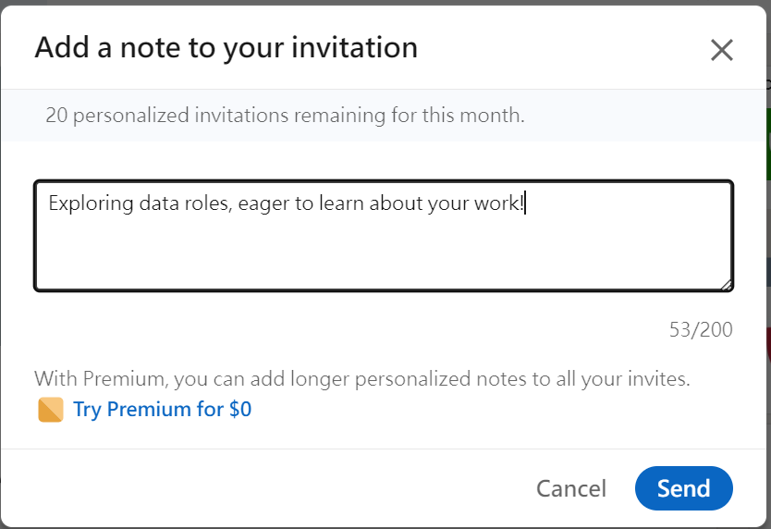
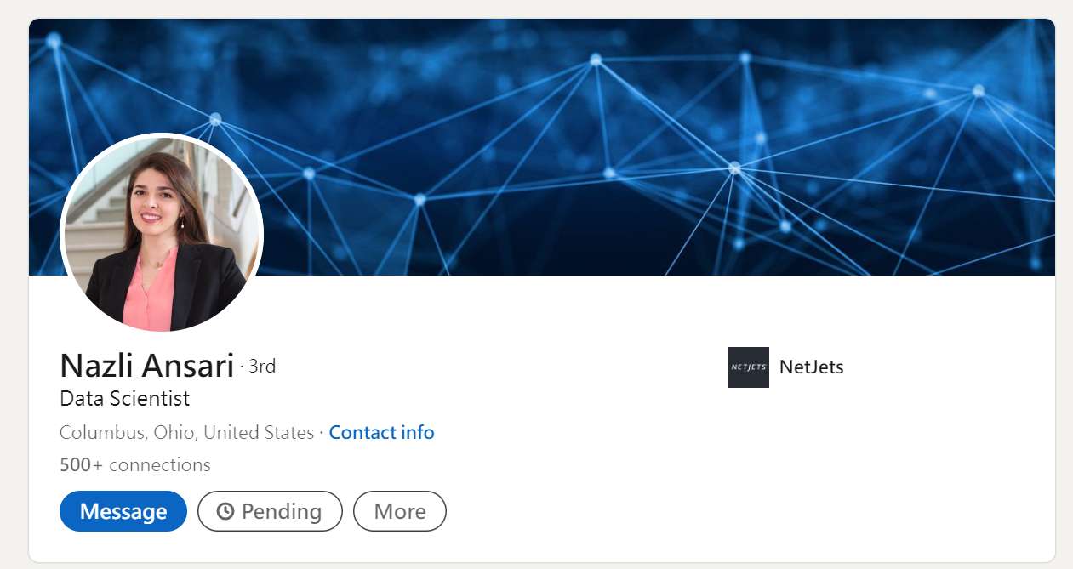

Example
P09 | Treatments
Notes:
https://www.flaticon.com/free-icon/woman_6997662?term=profile&page=1&position=21&origin=search&related_id=6997662

Slide 10
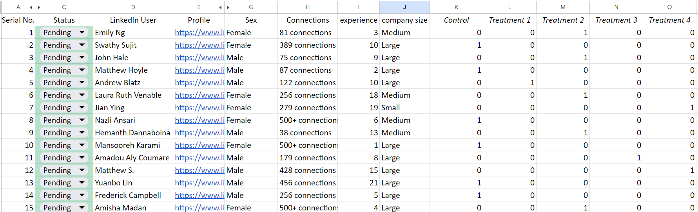
230 invitations
Data Collection
P10 | Execution
Notes:
Data Collection:
Sending up to 300 invitations.
Detail the process of random assignment using Excel.
Collection of the Linkedin user’s data including Name, Gender, Company size, number of connections, year of experience, etc.

Slide 11
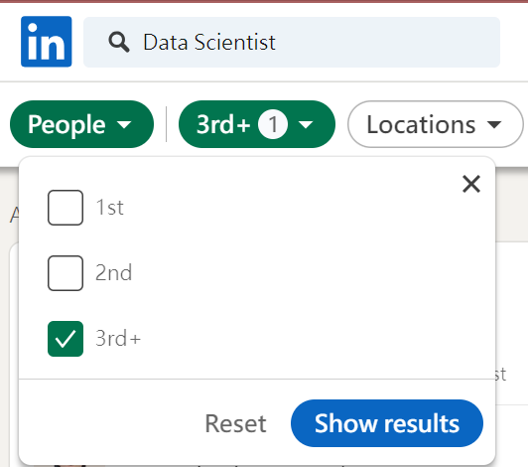

Randomization and Avoiding Bias
=RANDBETWEEN(1,5)
With Block Randomization for Gender
P11 | Execution
Notes:
1. Randomization - Random number generator used in excel for each connection to assign treatment
2. Excludability - 3+ connections, Location changed to east coast, only data scientists
3. Non-interference - ensure that the persons one connection is not connected to the other, i.e 3+ connections
LinkedIn profiles that are 3rd-degree connections to avoid bias
In our experiment design, we use an Excel function “Rand” to generate random numbers from 1 to 5 and distribute how we should send out the invitation prompt accordingly. Random number generator used in excel for each connection to assign treatment
<a href="https://www.flaticon.com/free-icons/random" title="random icons">Random icons created by Freepik - Flaticon</a>

Slide 12

Challenges with experiment design
Non Compliance
Attrition
Spillover
P12 | Challenges
Notes:
Non Compliance - We can’t not know if the user we sent out connection request login their account during our experiment period or not, the possible approach would be send out the invitation to those have recent posts or timeline updates on their profile, but it’s not practical given our limited timeline and expected sample size. Another way is to enlarge sample size so that we can have a more solid result even if we may face non compliance during experiment.
Attrition - given that attrition is someone drop out of the experiment, the situation may not be applicable in our linkedin experiment because once people see the invitation, whatever their decision is, they already provide the result - like if they decide not to respond, it would be “not accepted” in our records.
Spillover - Send out invitation on the same day to avoid the user share the same connection and become 2nd degree connection.
https://www.flaticon.com/free-icon/chat_6719666?term=chat+box&page=2&position=16&origin=search&related_id=6719666

Slide 13
Execution
Pilot results:
Expected effect size f2 = 0.15
alpha = 0.05
power = 0.8
Required sample size is 118
P13 | Data Analysis

Slide 14
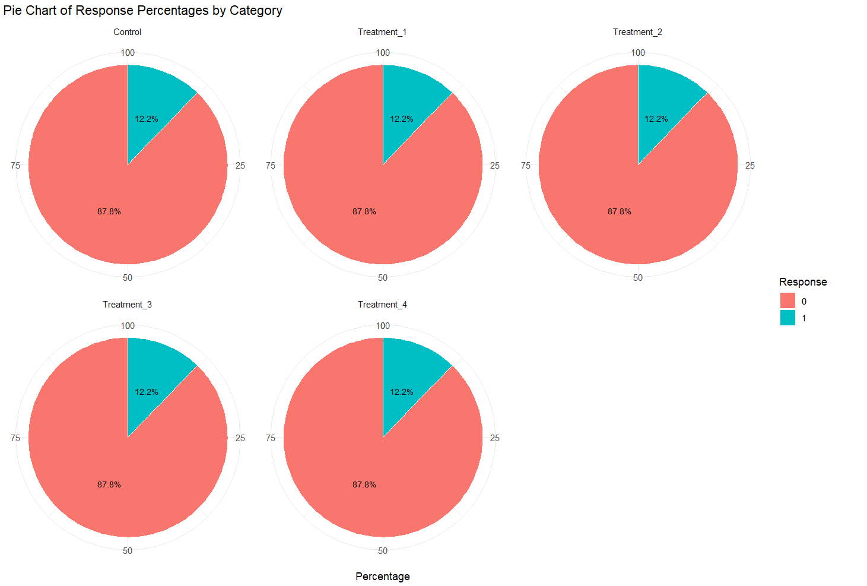
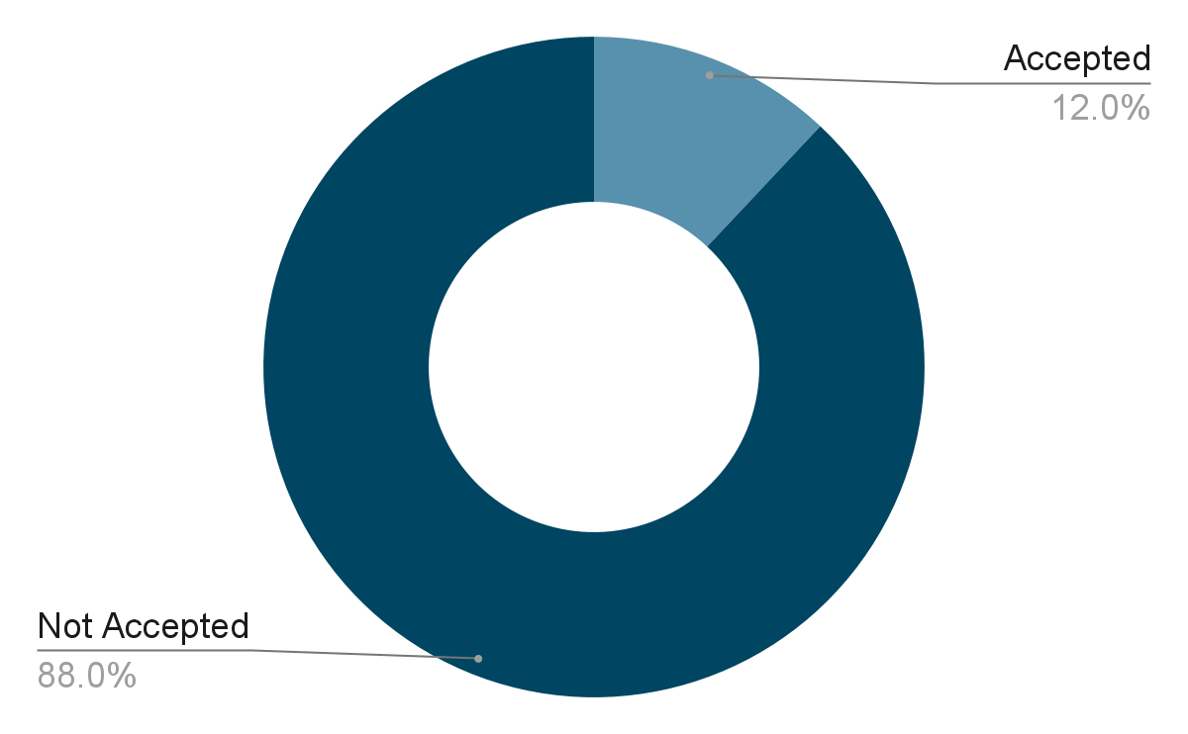
Experiment Result Summary
P14 | Data Analysis

Slide 15
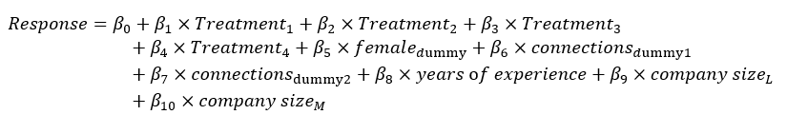
Data Analysis
Initial Model
P15 | Data Analysis

Slide 16
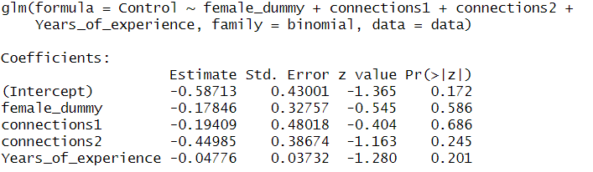
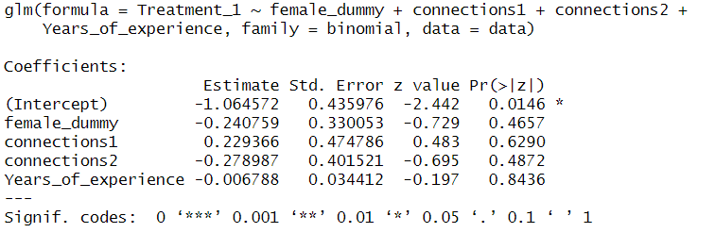
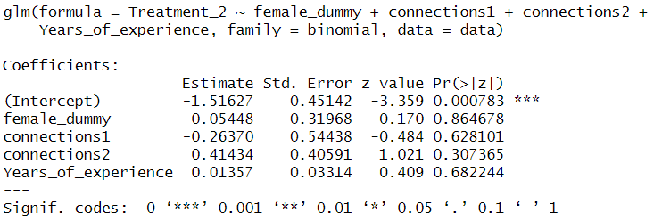
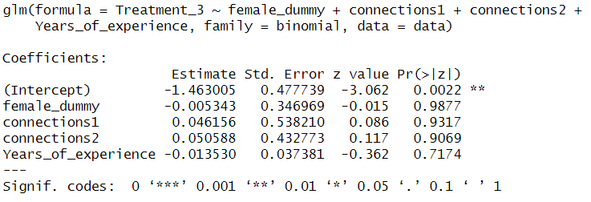
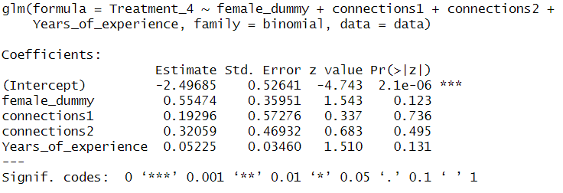
Covariate Imbalance check
P16 | Data Analysis

Slide 17
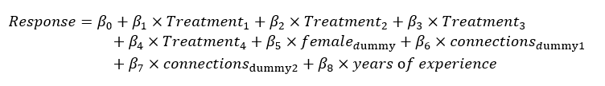
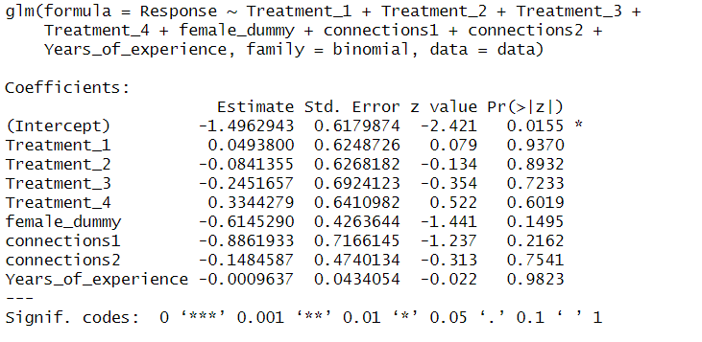
Final Model
Final Model
P17 | Data Analysis

Slide 18
Result Summary
Treatment Variables: None of the treatment variables are statistically significant. None of the treatment messages significantly change the odds of acceptance compared to the baseline
Female Dummy: With a p-value of 0.6032, being female does not significantly change the log odds of acceptance.
Number of Connections variable: All have p-values well above 0.05, connections does not have a significant effect on the acceptance rate within the ranges defined.
Years of experience: Also not statistically significant (p-value = 0.1838), suggesting that years of experience do not significantly impact the odds of acceptance.
P18 | Conclusion

Slide 19
Improvement
Omitted variable bias
Collect more details like the receiver’s ethnicity and observe interaction between receiver and sender’s ethnicity.
Generalizability of the model
Increase sample size and include people from other job titles and industries to provide a more generalizable result.
P19 | Conclusion

Slide 20
Thank you

